Slide 1
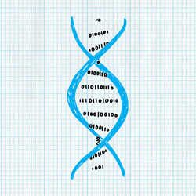
January 27, 2021
Science of Living System
BS20001 (2-0-0)
Dibyendu Samanta
School of Bio Science
Email: dibyendu.samanta@iitkgp.ac.in
Tel: 03222-260295

Slide 2
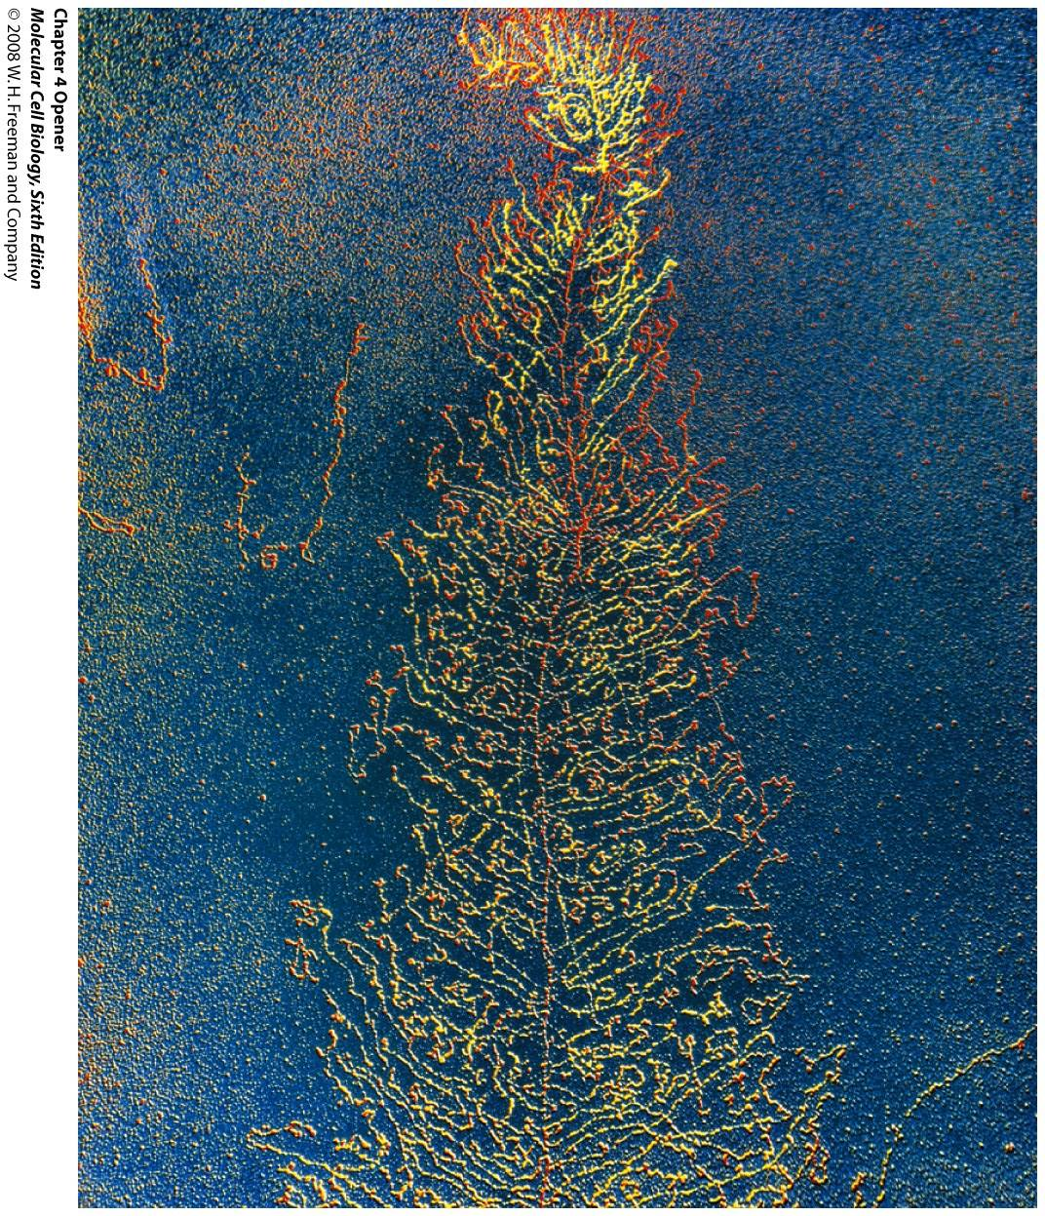
Overview of Transcription and Translation
[How genetic information get processed?]

Slide 3
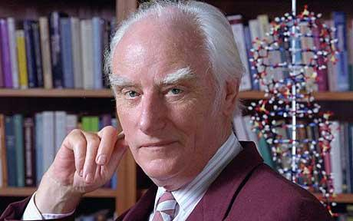
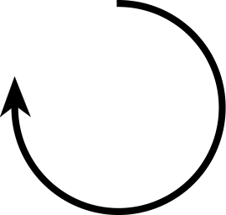
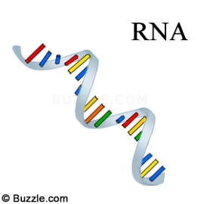
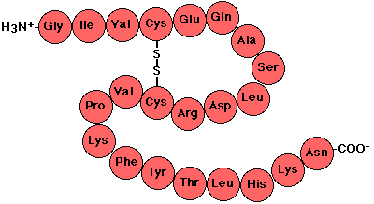
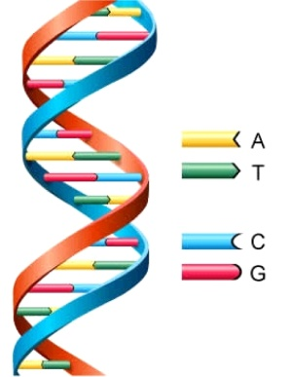
Flow of Genetic Information: The Central Dogma of Molecular Biology
DNA Polymerase
RNA Polymerase
Nobel Prize in 1962 for DNA Structure
Ribosome
DNA
RNA
Protein
Transcription
Translation
Replication
DNA
RNA
Protein
Polymer of nucleotides
Polymer of nucleotides
Polymer of amino acids

Slide 4
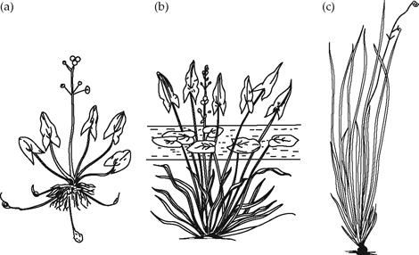
DNA: Contains the Instruction for Life
Hoxc8
Plant-X
Plant-Y
Plant-Z
Completely terrestrial Partially submerged Completely submerged
The phenotype (visible configuration) of the marsh plant Sagittaria sagittifolia depends on its environment

Slide 5
Correlations Between DNA Content and Its Down-stream Product
Transcription
Translation
DNA
RNA
Protein

Slide 6


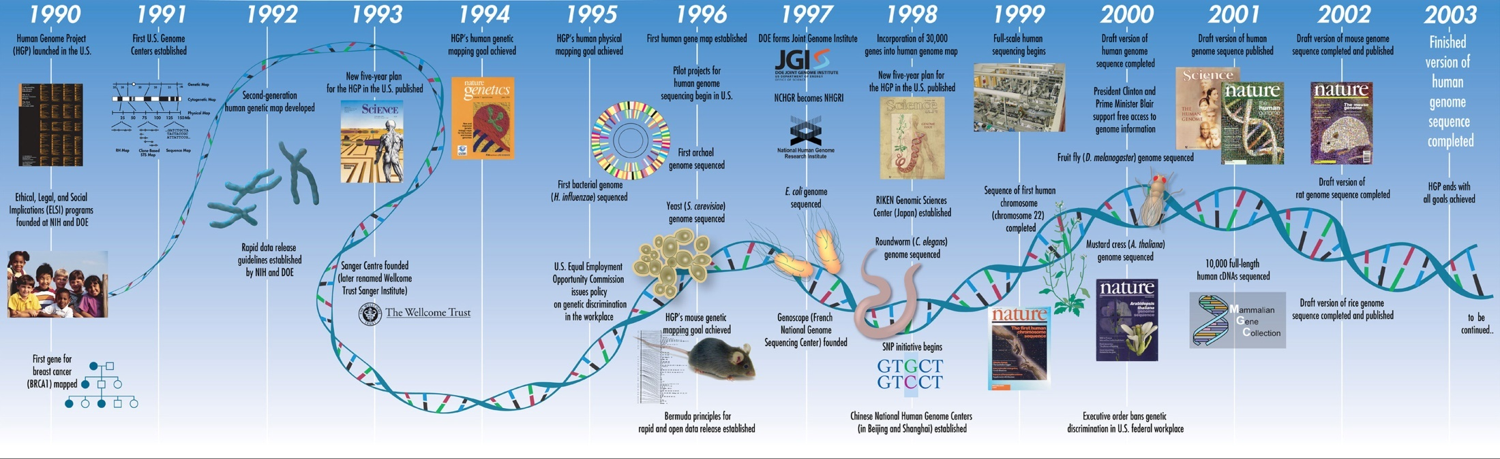
“Human Genome Project” Dramatically Enhanced Our Understanding on Gene Expression
∼21,000 human genes (appeared to be significantly fewer than previous estimates)

Slide 7
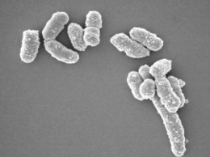
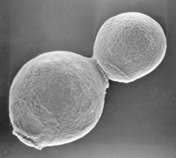
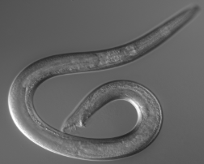
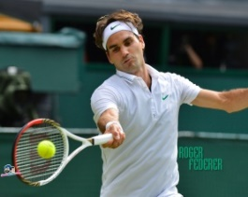
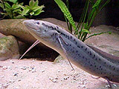
Genome Size, Gene Number, and Complexity of an Organism
Organism Genome size (bp) Protein coding genes
E. coli 4,600,000 4,250
S. cerevisiae 12,160,000 5,616
C. elegans 100,000,000 19,735
Human 3,200,000,000 19,042
Marbled lungfish 139,000,000,000 NA

Slide 8


Transcription
Genome size (bp)
Total DNA content vs transcribable content
4,600,000
3,200,000,000
►Protein coding sequences is ~1.5% of total DNA content (human)
Messenger RNA (mRNA)
►Besides protein coding region, DNA can be transcribed into:
Ribosomal RNA (rRNA)
Transfer RNA (tRNA)
►Most of the DNA sequences are not transcribed

Slide 9
What is a Machine?
A piece of equipment with several moving parts that uses power to do a particular type of work.
Cambridge dictionary
Biological machines:
DNA polymerase
RNA polymerase
Ribosome

Slide 10
Transcription: Involved Machineries and Processes
Promoter
Start
Stop
gene
Key points to be discussed
Promoter
RNA Polymerase
RNA synthesis
RNA Polymerase
5’
3’
3’
5’
5’
Initiation
Elongation
Termination
3’
5’
Nascent mRNA

Slide 11
Promoter for Transcription
Promoter is just like a “pointer” that points to the location of the information (gene) to be copied into mRNA
-10
+1
Coding strand
5’
TATAAT
ATTGCGATGG
3’
Template strand
3’
Promoter
TAACGCTACC
5’
5’
3’
Prokaryotic promoter
AUUGCGAUGG
-25
+1
Coding strand
5’
TATAAA
AGTGCTATGG
3’
Template strand
3’
TATA box
(Promoter)
TCACGATACC
5’
Eukaryotic promoter

Slide 12
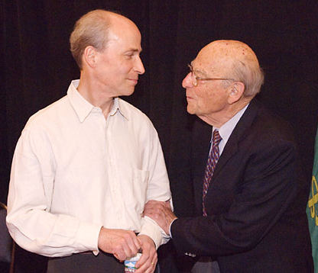
RNA Polymerase
Subunits of RNA Polymerase: α, α, β, β’ and σ
Holoenzyme: α, α, β, β’ and σ
Coreenzyme: α, α, β and β’
β’
gene
β
σ
Roger Kornberg
Nobel Prize in 2006
α
α
►RNA polymerase is completely Processive: A transcript is synthesized from start to end by a single RNA polymerase molecule.
σ
►RNA polymerase can initiate the synthesis of RNA de-novo (No primer required)
RNA Molecules in E. coli
Who transcribes this huge pool of rRNA and tRNA?
mRNA 5%
tRNA 15%
rRNA 80%
In bacteria same RNA polymerase transcribe all these three types of RNA
In eukaryotes different RNA polymerases are involved in transcription of mRNA, rRNA and tRNA
Notes:
Everything in eukaryotes is little more complex compare to bacteria. Although the basic architectures of these processes are same, in eukaryotes we have more communications between different steps, more tools to regulate the activities, and a number of alternate options.

Slide 13
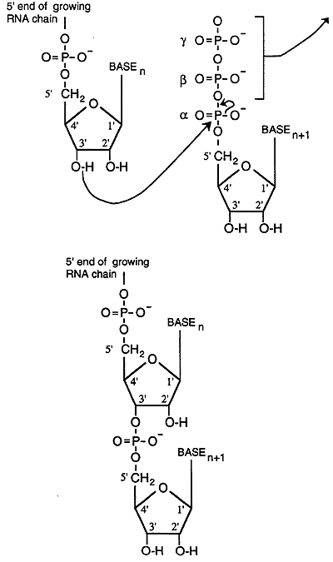
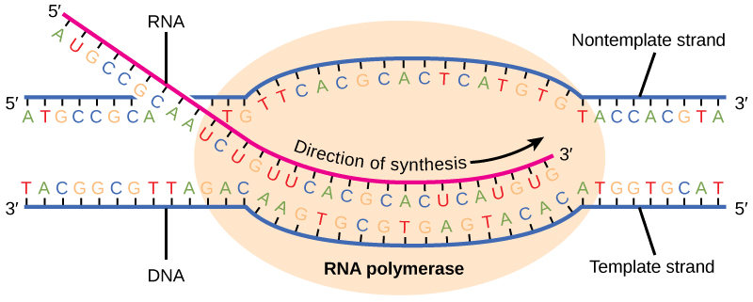
RNA Synthesis
Growing RNA chain
Coding strand
5’
+
3’
Ribonucleotide

Slide 14
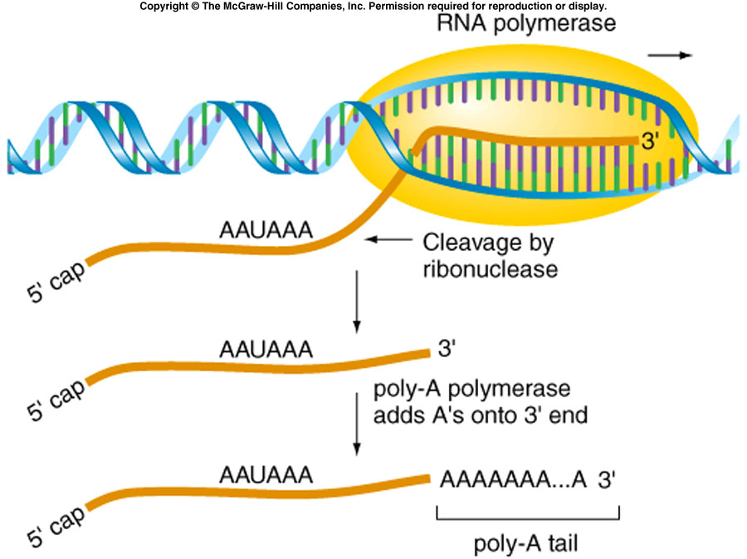
Eukaryotic Transcripts Need to be Processed
►Ends of a nascent mRNA acquire a 5’ cap and a 3’ poly A tail
●Increase stability of mRNA
●More effective template for translation

Slide 15
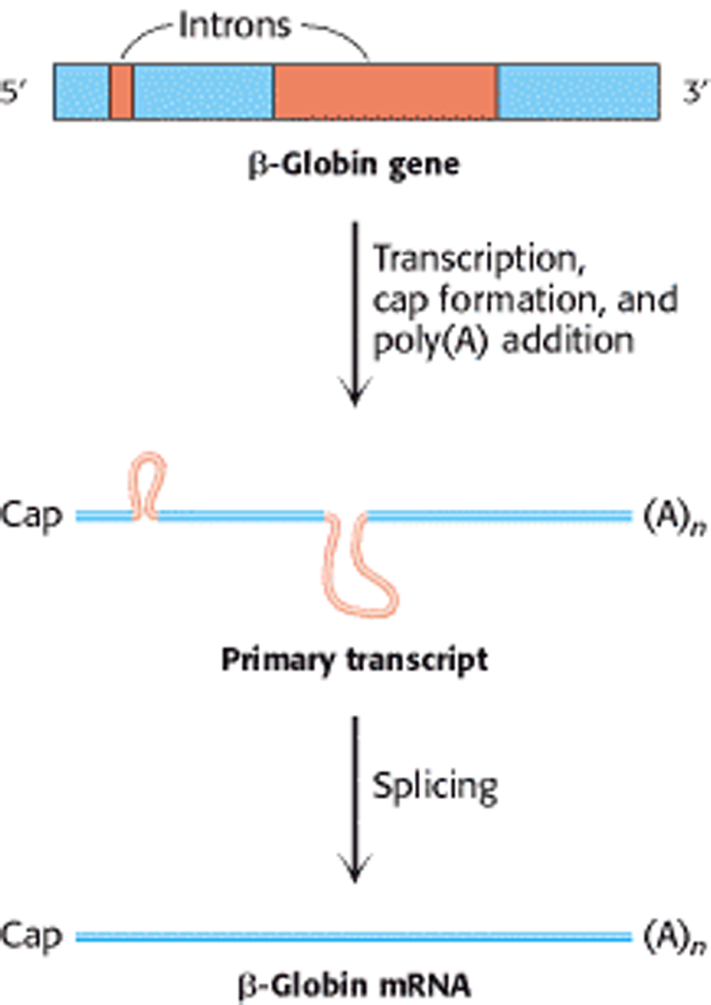
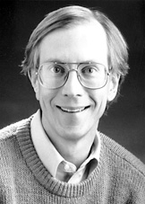
Eukaryotic Transcripts Need to be Processed
►Splicing (mediated by specialized enzymatic machineries consisting of snRNAs and proteins) removes introns from nascent mRNA
β-Globin gene
Transcription
Cap formation
Poly(A) addition
Thomas Cech
Nobel prize in 1989
Primary transcript
Splicing
**Splicing generates more variation
β-Globin mRNA

Slide 16
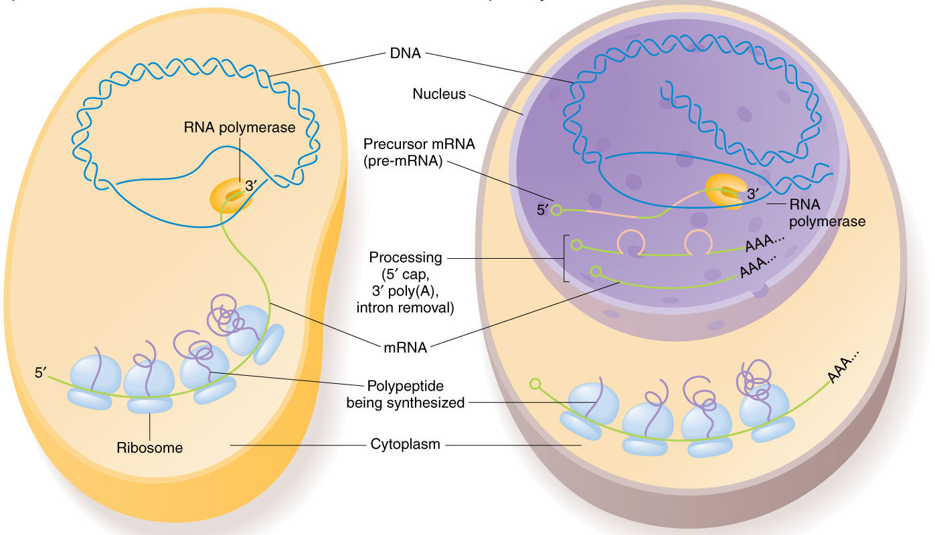
Transcription: At a Glance
Bacteria
Eukaryote

Slide 17
Regulation of Gene Expression
(Biological circuits)
0
1
1

Slide 18
Regulation of Gene Expression
Each cell contains all the genetic material for growth and development
Some of these genes are expressed all the time
Other genes are not expressed all the time. They are switched on an off at need

Slide 19
Lac Operon: A Classic Example of Bacterial Gene Expression Control
Operon: Cluster of genes, related by function, regulated by a single promoter and transcribed into one mRNA (polycistronic).
RNA Polymerase
mRNA
lacZ
lacY
lacA
promoter
Lac Operon
lacZ | β-galactosidase | Breaks lactose into galactose and glucose.
lacY | lactose permease | Imports lactose into the bacterial cell.
lacA | thiogalactoside transacetylase | Cell detoxification.

Slide 20
Functional Outcome of Lac Operon
RNA Polymerase
Transcription
lacZ
lacY
lacA
promoter
Ribosome
Thiogalactoside
transacetylase
Polycistronic
mRNA
lactose permease
β-galactosidase

Slide 21
Lac repressor is a negative regulator of the Lac operon
RNA Polymerase
Lac repressor
lacZ
lacY
lacA
Lac operator
Lac Operon
lacZ | β-galactosidase | Breaks lactose into galactose and glucose.
lacY | lactose permease | Imports lactose into the bacterial cell.
lacA | thiogalactoside transacetylase | Cell detoxification.

Slide 22
Lactose (Allolactose) Can Displace Lac Repressor From the Operator Site
RNA Polymerase
Lac repressor
lacZ
lacY
lacA
Lac operator
Lac Operon
Lac repressor
Lac repressor
Allolactose
(Inducer)
Lac operator
Lac operator

Slide 23
Four Possible Situations
Glucose | Lactose | Lac repressor bound | Lac operon
1 | 0 | YES | OFF (0)
1 | 1 | YES | OFF (0)
0 | 1 | NO | ON (1)
0 | 0 | YES | OFF (0)
RNA Polymerase
Lac repressor
lacZ
lacY
lacA
Lac pomoter
Lac operator
Lac Operon
NOT
Glucose
AND
Lac Operon
Lactose

Slide 24
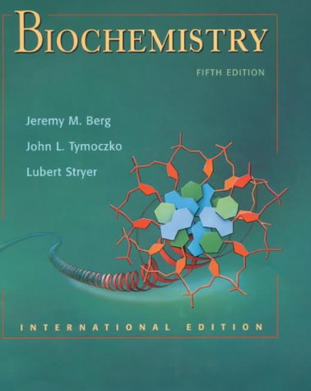
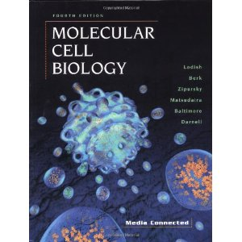
Suggested Textbook…
Stryer…
Baltimore, Lodish..

Slide 25
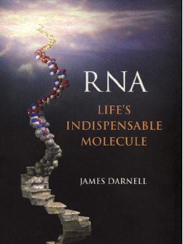
Extra Resources
Further Reading...
Videos…
mRNA synthesis (Transcription)
https://www.youtube.com/watch?v=_C9Un4dlpR4
Protein synthesis (Translation)
https://www.youtube.com/watch?v=Ikq9AcBcohA
Overview
https://www.youtube.com/watch?v=gG7uCskUOrA
James Darnell

